Slide 1

MAKING SIMPLE DECISIONS
247
Let us associate each state S with a numeric utility U(S), which expresses the desirability of the state
A nondeterministic action A will have possible outcome states
Resulti(A), where the index i ranges over the different outcomes
Prior to the execution of A the agent assigns probability
P(Resulti(A) | Do(A), E) to each outcome, where E
summarizes the agent’s available evidence of the world
The expected utility of A can now be calculated:
EU(A | E) = _{i} P(Result_{i}(A) | Do(A), E) · U(Result_{i}(A))
248
The principle of Maximum expected utility (MEU) says that a rational agent should choose an action that maximizes the agent’s expected utility
If we wanted to choose the best sequence of actions using this equation, we would have to enumerate all action sequences, which is clearly infeasible for long sequences
If the utility function correctly reflects the performance measure by which the behavior is being judged, then using MEU the agent will achieve the highest possible performance score averaged over the environments in which it could be placed
Let us model a nondeterministic action with a lottery L, where
possible outcomes C1, …, Cn can occur with probabilities p1, …, pn
L = [p1, C1; p2, C2; …; pn, Cn]
1

Slide 2
249
16.2 The Basis of Utility Theory
A B Agent prefers lottery A over B
A ~ B The agent is indifferent between A and B
A B The agent prefers A to B or is indifferent between them
Deterministic lottery [1,A] A
Reasonable constraints on the preference relation (in the name of rationality)
  Orderability: given any two states, a rational agent must either prefer one to the other or else rate the two as equally preferable.
(A B) (B A) (A~B)
  Transitivity:
(A B) (B C) (A C)
250
Continuity:
A B
Substitutability:
A ~ B
Monotonicity:
C p: [p, A; 1-p, C] ~ B
[p, A; 1-p, C] ~ [p, B; 1-p, C]
A B (p q [p, A; 1-p, B] [q, A; 1-q, B])
Decomposability: Compound lotteries can be reduced to simpler ones by the laws of probability
[p, A; 1-p, [q, B; 1-q, C]] ~ [p, A; (1-p)q, B; (1-p)(1-q), C]
Notice that the axioms of utility theory do not say anything about utility
The existence of a utility function follows from them

Slide 3
251
And then there was Utility
Utility principle:
If an agent’s preferences follow the axioms of utility, then there exists a real-valued function U s.t.
U(A) > U(B) A B
U(A) = U(B) A ~ B
Maximum Expected Utility principle: The utility of a lottery is
U([p1, S1; …; pn, Sn]) = i=1,…,npi·U(Si)
Because the outcome of a nondeterministic action is a lottery, this gives us the MEU decision rule from slide 247
252
16.3 Utility Functions
Money (or an agent’s total net assets) would appear to be a straightforward utility measure
The agent exhibits a monotonic preference for definite amounts of money
We need to determine a model for lotteries involving money
  We have won a million euros in a TV game show
  The host offers to flip a coin, if the coin comes up heads, we end up with nothing, but if it comes up tails, we win three millions
  Is the only rational choice to accept the offer which has the
expected monetary value of 1,5 million euros?
The true question is maximizing total wealth (not winnings)

Slide 4
253
The axioms of utility do not specify a unique utility function for an agent
For example, we can transform a utility function U(S) into
U'(S) = k1 + k2·U(S)
where k1 is a constant and k2 is any positive constant
Clearly, this linear transformation leaves the agent’s behavior
unchanged
In deterministic contexts, where there are states but no lotteries, behavior is unchanged by any monotonic transformation
E.g., the cube root of the utility (U(S))
Utility function is ordinal — it really provides just rankings of states rather than meaningful numerical values
254
The scale of utilities reaches from the best possible prize u to the worst possible catastrophe u
Normalized utilities use a scale with u = 0 and u = 1
Utilities of intermediate outcomes are assessed by asking the agent to indicate a preference between the given outcome state S and a standard lottery [p, u ; 1-p, u ]
The probability p is adjusted until the agent is indifferent between S and the standard lottery
Assuming normalized utilities, the utility of S is given by p

Slide 5
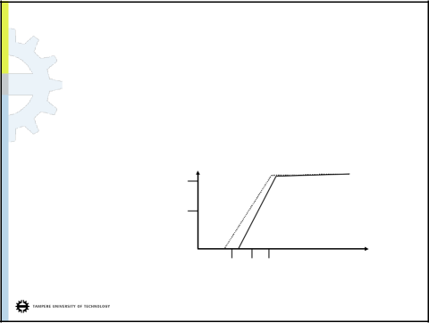
16.4 Multiattribute Utility Functions
255
Most often the utility is determined by the values x = [x1, …, xn]
of multiple variables (attributes) X = X1, …, Xn
For simplicity, we will assume that each attribute is defined in
such a way that, all other things being equal, higher values of the attribute correspond to higher utilities
If for a pair of attribute vectors x and y it holds that xi yii, then x strictly dominates y
Suppose that airport site S1 costs less, generates less
noise pollution, and is safer than site S2, one would not hesitate to reject the latter
In the general case, where the action outcomes are uncertain,
strict dominance occurs less often than in the deterministic case
Stochastic dominance is more useful generalization
256
Suppose we believe that the cost of siting an airport is uniformly distributed between
  S1: 2.8 and 4.8 billion euros
  S2: 3.0 and 5.2 billion euros
Then by examining the cumulative distributions, we see that
S1 stochastically dominates S2 (because costs are negative)
1.0
probability
.5
S
2
S
1
-5 -4 -3
Negative costs
5

Slide 6
257
Cumulative distribution integrates the original distribution
If two actions A₁ and A₂ lead to probability distributions p₁(x)
and p₂(x) on attribute X
A1 stochastically dominates A2 on X if
x: - ,…,x p1(x') dx’- ,…,x p2(x') dx'
If
  A1 stochastically dominates A2,
  then for any monotonically nondecreasing utility function
U(x),
the expected utility of A1 is at least as high as that of A2
Hence, if an action is stochastically dominated by another action
on all attributes, then it can be discarded
258
16.6 The Value of Information
BP is hoping to buy one of n indistinguishable blocks of ocean drilling rights at the Gulf of Mexico
Exactly one of the blocks contains oil worth C euros
The price for each block is C/n euros
A seismologist offers BP the results of a survey of block #3, which indicates definitively whether the block contains oil
How much should BP be willing to pay for the information?
  With probability 1/n, the survey will indicate oil in block #3, in which case BP will buy the block for C/n euros and make a profit of (n-1)C/n euros
  With probability (n-1)/n, the survey will show that the block contains no oil, in which case BP will buy a different block

Slide 7
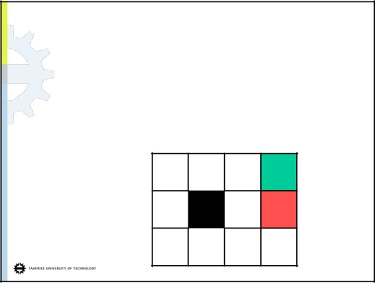
259
Now the probability of finding oil in one of the other blocks changes to 1/(n-1), so BP makes an expected profit of C/(n-1) - C/n = C/n(n-1) euros
Now we can calculate the expected profit, given the survey information:
(1/n)·((n-1)C/n) + ((n-1)/n)·(C/n(n-1)) = C/n
Therefore, BP should be willing to pay the seismologist up to the price of the block itself
With the information, one’s course of action can be changed to suit the actual situation
Without the information, one has to do what’s best on
average over the possible situations
260
17 MAKING COMPLEX DECISIONS
The agent’s utility now depends on a sequence of decisions
In the following 4 × 3 grid environment the agent makes a decision to move (U, R, D, L) at each time step
When the agent reaches one of the goal states, it terminates
The environment is fully observable — the agent always knows where it is
+1
-1
Start

Slide 8
261
If the environment were deterministic, a solution would be easy: the agent will always reach +1 with moves [U, U, R, R, R]
Because actions are unreliable, a sequence of moves will not always lead to the desired outcome
Let each action achieve the intended effect with probability 0.8 but with probability 0.1 the action moves the agent to either of the right angles to the intended direction
If the agent bumps into a wall, it stays in the same square
Now the sequence [U, U, R, R, R] leads to the goal state with
probability 0.8⁵ = 0.32768
In addition, the agent has a small chance of reaching the goal by accident going the other way around the obstacle with a
probability 0.1⁴ × 0.8, for a grand total of 0.32776
Department of Software Systems
OHJ-2556 Artificial Intelligence, Spring 2010
6.5.2010
262
A transition model specifies outcome probabilities for each action in each possible state
Let T(s, a, s') denote the probability of reaching state s' if action
a is done in state s
The transitions are Markovian in the sense that the probability of reaching s’ depends only on s and not the earlier states
We still need to specify the utility function for the agent
The decision problem is sequential, so the utility function depends on a sequence of states — an environment history
— rather than on a single state
For now, we will simply stipulate that is each state s, the agent receives a reward R(s), which may be positive or negative

Slide 9
263
For our particular example, the reward is -0.04 in all states except in the terminal states
The utility of an environment history is just (for now) the sum
of rewards received
If the agent reaches the state +1, e.g., after ten steps, its total utility will be 0.6
The small negative reward gives the agent an incentive to reach
[4, 3] quickly
A sequential decision problem for a fully observable environment with
  A Markovian transition model and
  Additive rewards
is called a Markov decision problem (MDP)
Department of Software Systems
OHJ-2556 Artificial Intelligence, Spring 2010
6.5.2010
264
An MDP is defined by the following three components:
  Initial state S0,
  Transition model T(s, a, s'), and
  Reward function R(s)
As a solution to an MDP we cannot take a fixed action sequence, because the agent might end up in a state other than the goal
A solution must be a policy, which specifies what the agent should do for any state that the agent might reach
The action recommended by policy for state s is (s)
If the agent has a complete policy, then no matter what the outcome of any action, the agent will always know what to do next

Slide 10
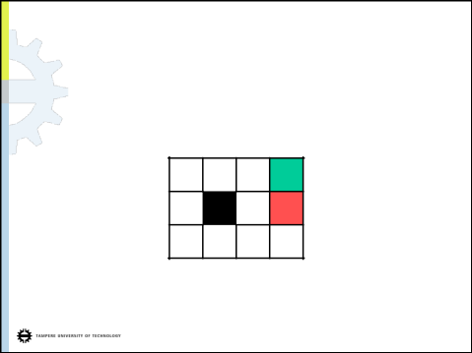
265
Each time a given policy is executed starting from the initial state, the stochastic nature of the environment will lead to a different environment history
The quality of a policy is therefore measured by the expected utility of the possible environment histories generated by the policy
An optimal policy * yields the highest expected utility
-1
A policy represents the agent function explicitly and is therefore a description of a simple reflex agent
266
-0.0221 < R(s) < 0:
 |  |  | +1
 |  |  | -1
-0.4278 < R(s) < -0.0850:
 |  |  | +1
 |  |  | -1
Department of Software Systems
OHJ-2556 Artificial Intelligence, Spring 2010
6.5.2010

Slide 11
267
R(s) < -1.6284:
 |  |  | +1
 |  |  | -1
R(s) > 0:
 |  |  | +1
 |  |  | -1
Department of Software Systems
x
6.5.
268
Optimality in sequential decision problems
In case of an infinite horizon the agent’s action time has no upper bound
With a finite time horizon, the optimal action in a given state could change over time — the optimal policy for a finite horizon is nonstationary
With no fixed time limit, on the other hand, there is no reason to behave differently in the same state at different times, and the optimal policy is stationary
The discounted utility of a state sequence s0, s1, s2, … is
R(s0) + R(s1) + ²R(s2) + …,
where 0 < 1 is the discount factor

Slide 12
269
When = 1, discounted rewards are exactly equivalent to additive rewards
The latter rewards are a special case of the former ones
When is close to 0, rewards in the future are viewed as insignificant
If an infinite horizon environment does not contain a terminal state or if the agent never reaches one, then all environment histories will be infinitely long
Then, utilities with additive rewards will generally be infinite
With discounted rewards ( < 1), the utility of even an infinite sequence is finite
270
Let Rmax be an upper bound for rewards. Using the standard formula for the sum of an infinite geometric series yields:
t=0,…, ^{t} R(st) t=0,…, ^{t} Rmax = Rmax/(1 - )
Proper policy guarantees that the agent reaches a terminal state when the environment contains such
With proper policies infinite state sequences do not pose a problem, and we can use = 1 (i.e., additive rewards)
An optimal policy using discounted rewards is
*= arg max E[ t=0,…, ^{t} R(st) | ],
where the expectation is taken over all possible state sequences that could occur, given that the policy is executed

Slide 13
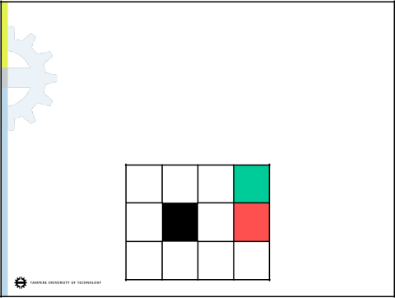
17.2 Value Iteration
271
For calculating an optimal policy we
  calculate the utility of each state and
  then use the state utilities to select an optimal action in each state
The utility of a state is the expected utility of the state sequence that might follow it
Obviously, the state sequences depend on the policy that is executed
Let st be the state the agent is in after executing for t steps
Note that st is a random variable
Then we have
U (s) = E[ t=0,…, ^{t} R(st) | , s0 = s ]
272
The true utility of a state U(s) is just U *(s)
R(s) is the short-term reward for being in s, whereas U(s) is the long-term total reward from s onwards
In our example grid the utilities are higher for states closer to the
+1 exit, because fewer steps are required to reach the exit
0.812 0.868 0.912 +1
0.762
0.660 -1
0.705 0.655 0.611 0.388

Slide 14
273
The agent may select actions using the MEU principle
*(s) = arg maxa s‘ T(s, a, s') U(s') (*)
The utility of state s is the expected sum of discounted rewards from this point onwards, hence, we can calculate it:
  Immediate reward in state s, R(s), +
  The expected discounted utility of the next state, assuming that the agent chooses the optimal action
U(s) = R(s) + maxa s‘ T(s, a, s') U(s')
This is called the Bellman equation
If there are n possible states, then there are n Bellman equations, one for each state
274
U(1,1) = -0.04 + max{ 0.8 U(1,2) + 0.1 U(2,1) + 0.1 U(1,1), (U)
0.9 U(1,1) + 0.1 U(1,2), (L)
0.9 U(1,1) + 0.1 U(2,1), (D)
0.8 U(2,1) + 0.1 U(1,2) + 0.1 U(1,1) } (R)
Using the values from the previous picture, this becomes:
U(1,1) = -0.04 +
max{ 0.6096 + 0.0655 + 0.0705 = 0.7456,
0.6345 + 0.0762= 0.7107,
0.6345 + 0.0655= 0.7000,
0.5240 + 0.0762+ 0.0705 = 0.6707 }
(U)
(L)
(D)
(R)
Therefore, Up is the best action to choose

Slide 15
275
Simultaneously solving the Bellman equations using does not work using the efficient techniques for systems of linear equations, because max is a nonlinear operation
In the iterative approach we start with arbitrary initial values for the utilities, calculate the right-hand side of the equation and plug it into the left-hand side
Ui+1(s) R(s) + maxa _{s‘} T(s, a, s') U_{i}(s'),
where index i refers to the utility value of iteration i
If we apply the Bellman update infinitely often, we are guaranteed to reach an equilibrium, in which case the final utility
values must be solutions to the Bellman equations
They are also the unique solutions, and the corresponding
policy is optimal
276
17.3 Policy Iteration
Beginning from some initial policy 0 alternate:
  Policy evaluation: given a policy i, calculate Ui = U ^{i}, the utility of each state if i were to be executed
  Policy improvement: Calculate the new MEU policy i+1, using one- step look-ahead based on Ui (Equation (*))
The algorithm terminates when the policy improvement step yields no change in utilities
At this point, we know that the utility function U_{i} is a fixed point of the Bellman update and a solution to the Bellman equations,
so _{i} must be an optimal policy
Because there are only finitely many policies for a finite state space, and each iteration can be shown to yield a better policy, policy iteration must terminate

Slide 16
277
Because at the ith iteration the policy i specifies the action
i(s) in state s, there is no need to maximize over actions in policy iteration
We have a simplified version of the Bellman equation:
Ui(s) = R(s) + s‘ T(s, _{i}(s), s') U_{i}(s')
Now the nonlinear max has been removed, and we have linear equations
A system of linear equations with n equations with n unknowns can be solved exactly in time O(n3) by standard linear algebra methods
Instead of using a cubic amount of time to reach the exact solution, we can instead perform some number simplified value iteration steps to give a reasonably good approximation of the utilities
16

